Slide 1

Project Title –
Keylogger Project using Python
ADARSH KUMAR TIWARI
Apply ID:APPLY_1763975338692420aa6b00d
Internship ID: INTERNSHIP_1762343729690b3b31bb89f

Slide 2

PROBLEM STATEMENT
Monitoring keyboard activity is essential for understanding how users interact with a system.
However, capturing key press, hold, and release events in real time and storing them in a structured format is challenging.
The problem is to design a simple application that:
Captures keyboard events accurately
Stores keystrokes securely
Provides a user-friendly interface
Saves data in readable and structured formats

Slide 3
Project Description
This project is a Python-based Keylogger application developed using Tkinter for the graphical user interface and pynput for keyboard event handling.
The application allows the user to start keylogging through a GUI button.
It captures:
Key Press
Key Hold
Key Release
The captured data is stored in: logs.json (structured format) logs.txt (readable keystroke sequence)
This project demonstrates event-driven programming, file handling, and GUI development in Python.

Slide 4

WHO ARE THE END USERS?
Students learning Python programming
Learners studying Operating Systems and event handling
Cybersecurity students (for educational and ethical use only)
Developers testing keyboard input behavior
Researchers analyzing typing patterns (with user consent)

Slide 5

Technology Used
Python – Core programming language
Tkinter – Used to design the graphical user interface
pynput library – Used to capture keyboard events
JSON – Used for structured data storage
Text File Handling – Used to store readable keystrokes

Slide 6
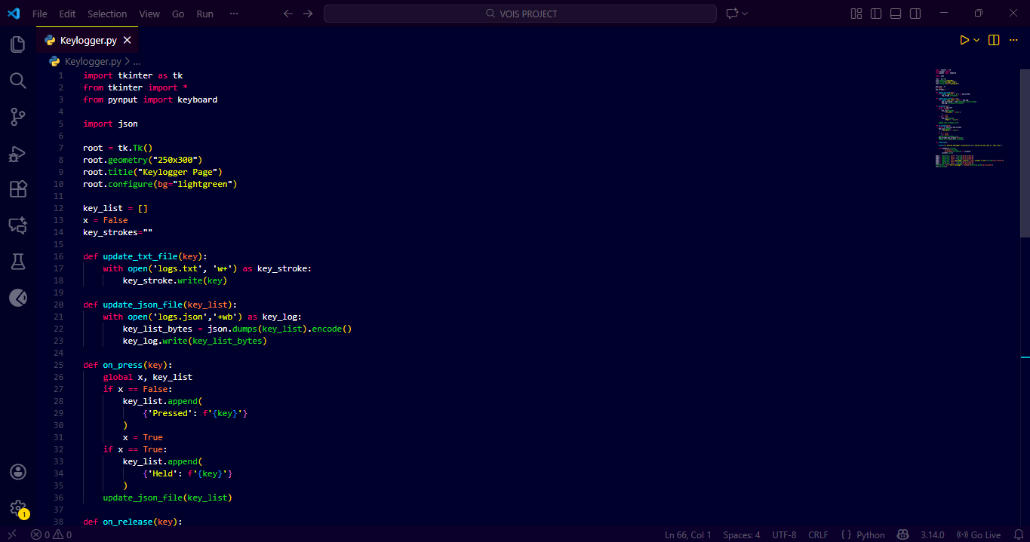
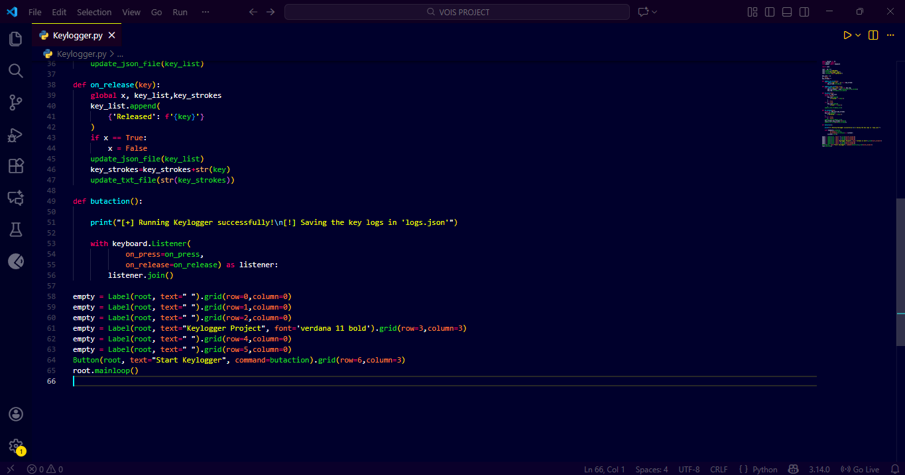
RESULTS

Slide 7
DEMO LINK :
https://github.com/Adarshh18/VOIS-AICTE-Cyber-Security-Project.git

Slide 8
Thank you
.
.

